Slide 2

Saranya Sriram
Principal PM Lead, Azure Cosmos DB, Microsoft

Slide 3

Overview and Latest Improvements on Azure Cosmos DB
Saranya Sriram
@sharan779

Slide 4
Introduction to Azure Cosmos DB
Use Cases and Customer references
Demo – Portal, Resource Model &System Internals
Partitioning
Agenda
Request Units and Elasticity
Azure Cosmos DB HTAP for OLTP & OLAP
Preview Announcements & Closing
Q & A

Slide 5
Introduction to Azure Cosmos DB

Slide 6
Azure Cosmos DB
Azure Cosmos DB
Fast, distributed database with relational and non-relational APIs for any scale
Serverless Guaranteed speed at any scale,
best TCO
Schema-less, flexible app development
NoSQL, MongoDB, Cassandra, Gremlin, Postgres
Globally distributed,
RTO=0
99.999 SLA
Real time
analytics & BI
with Synapse Link

Slide 7
Cloud native database
Gigabytes of data
Petabytes of data
Cost efficiencies with fine-grained multi-tenancy
3
Hundreds transactions/sec
Millions of transactions/sec
2
Elastic and unlimited scalability
Performance
isolation
Adaptive resource
governance
Global Distribution
Fine grained multi-tenancy
1
Commodity Hardware

Slide 8





Azure Cosmos DB
Core (NoSQL) API
MongoDB
Table API
Postgres API
Column-family
Document
Key-value
Graph
Guaranteed low latency at the 99th percentile
Relational
Elastic scale out
of storage & throughput
Five well-defined consistency models
Turnkey global distribution
Comprehensive SLAs

Slide 9
NewSQL Cloud Native Databases
NoSQL databases are defined by a collection of characteristics that they share rather than having a formal definition:
Non-relational
Scale-out
Schema-less
They were all born out of this desire to address new needs to the internet world.
NewSQL / D-SQL databases bring ACID constraints and strong query pushdown
Key–value databases
Column family databases
Document databases
Graph databases
Distributed Relational
Notes:
So NoSQL databases are now rather defined by a bunch of characteristics that they share rather than having a formal definition: non-relational, scale-out, schema-less are probably the ones I would call out as they apply to most databases that identify as NoSQL and they were all born out of this desire to address new needs to the internet world.
They are also all use different data model from the relational method of modeling data, typically characterized into 4 broad data model families.
Key–value databases
Column family databases
Document database
Graph databases
The simplest are key value stores they, allow you to save key value pairs and retrieve the values by providing the key. From a developer perspective this is similar to an in-memory hash map of the whole dataset, just saved to disk.
Next up the column family data model, this is essentially an extension of the key-value databases, it extends the model to include an additional secondary key on top of the primary key, typically referred to as column and rows keys respectively, this allows for the storage, retrieval and query of subsets of more complicated data structures whilst still maintaining the association of the data with row key directly. We will talk a little about why this important as we distribute the data across clusters later on.
The document data model, the model we are probably going to talk about the most today and over the next couple of sessions. It breaks the world down into documents, these could be any type of structured document but most commonly JSON. No developer really wants to publicly admit that they work/or have worked with XML these days. The document clearly exposes its content. And again here there is no predefined schema, there is no need to define up front, as you would tables and columns in the relational world, a strict structure to hold your data. This provides flexibility in what data is stored and makes it easier to transform data models overtime. That doesn’t mean we don’t need to think about the data we place in the documents and how we place these documents into the databases itself - there are still implicit functional contracts that exists with the applications that we build on top this data. We would not want to query a database for the latest house prices and only get back the average travel distance fruit has journeyed from farmer to table - just because you can store data of any type in any structure in the same database doesn’t necessarily mean you want to - you still need some strict structural guidelines to make the data useful to the applications we build. Additionally, how we model data also impacts the query performance of the database, we will drill into this a little more later on.
When we think about objects that we work on within our applications they are usually composed smaller objects and these all have properties that in turn values that are interesting. It is however the parent objects that usually the things write to and retrieving from the database as a single unit - the book with all its details and authors, rather than the authors individually one by one – we would typically rather hydrate a book object as a whole. And it’s this ability of the document databases that allows them to remove the impedance associated with saving and retrieving objects – books in this case. We can often just serialize the objects we have in memory and persist them directly to the database in a single operation - no more need for ORMs. And when we retrieve datasets from the database we can filter, project and de-serialize the results into new objects - hydrating our application object model directly with the query results.
I will say that the boundaries between key-value, column family and document databases are not always as clearly delineated as they may first appear.
The fourth type of NoSQL database is graph, these are modeled fundamentally differently. The graph databases super-power is querying relationships, and whilst the name relational databases leaves some to believe that that they would be good at this, they not, and the name is derived from the relations on set theory. To query relationships in SQL you often need to establish foreign keys specifically for the purpose and run expensive often recursive types of queries.
Graph databases are used completely differently with their fundamental data model being a graph structure constituted of nodes and edges (sometimes called relationships) and properties attaching additional values to the nodes. They have also developed their own query languages that can express the particulars of querying relationships efficiently, often very different from the SQL language.
So you can see that choosing a NoSQL database is in part and largely about how you want to work with your data.

Slide 10
Azure Cosmos DB
Develop modern apps with SLA-backed speed and availability, automatic and instant scalability, and open source APIs for many NewSQL engines
Guaranteed speed at any scale
Mission-critical ready
Gain unparalleled SLA-backed speed and throughput, fast global access, and instant elasticity.
Guarantee business continuity, 99.999% availability, and enterprise-level security for every application.
Simplified app development
Fully managed and cost-effective
Build fast with open source APIs, multiple SDKs, schema-less data, and no-ETL analytics over operational data.
End-to-end database management with serverless and automatic scaling matching your application and TCO needs.

Slide 11
Guaranteed speed at any scale
Latency
High Availability
Real-time access with <10 ms read and write latencies backed globally by SLA
The only service with financially-backed SLAs for millisecond read and write latency at the 99th percentile and 99.999% high availability
Turnkey multi-master writes and data distribution to any Azure region is enabled by a click of a button
Independently and elastically scale storage and throughput across any Azure region
<10 ms
99th percentile
99.999%
Throughput
Consistency
Guaranteed
Guaranteed

Slide 12
Simplified app development
The NoSQL schema flexibility removes the impedance mismatch between application object model and the database.
Deep integration with key Azure services used in cloud-native app development including Azure Synapse Analytics
Multiple APIs to access and query data, including Core (SQL), MongoDB, Cassandra, Gremlin, and Table
Languages of your choice with SDKs for .NET, Java, and Python
Change feed makes it easy to track and manage changes to database containers
Core (SQL) API
MongoDB
Table API

Slide 13
Mission-critical ready
Azure Cosmos DB offers a comprehensive suite of SLAs including industry-leading 99.999% availability worldwide
Azure Cosmos DB delivers zero downtime with 0 RPO
Turnkey multi-master writes enabled by a click of a button
Enjoy enterprise-grade end-to-end encryption and self-managed keys
Role-based access control keeps your data safe and offers fine-tuned control

Slide 14
Fully managed service
Fully managed database service automatically handles all maintenance and updates
Cost-effective serverless database operations model responds to app patterns and is ideally suited for small, spiky workloads with moderate performance requirements
Autoscale provisioned throughput offers high-performance guarantees for critical workloads while eliminating the need for direct throughput management

Slide 15
What is Cosmos DB : Database for Modern Applications
Today : Operational Needs​
High throughput ingestion of both batch & streaming feeds with real-time indexing​
Global distribution with active-active setup​
Apps to perform real-time CRUD & queries using developer friendly NoSQL APIs​
No downtime elastic scaling of database​
SLAs for latency/availability/consistency/throughput
Cosmos DB = Above +
Globally distributed
Multiple Model
Multi Master
Lowest Latency for read/write
Developer friendly
Auto Indexed ; AutoScale
Ring Zero
NoSQL LOB Apps
Enterprise Grade Security principals
Data Security including BYOK

Slide 16
Use Cases and Customer References

Slide 17
Powering global solutions - Use Cases
Azure Cosmos DB was built to support modern app patterns and use cases.
It enables industry-leading organizations to unlock the value of data, and respond to global customers and changing business dynamics in real-time.
Data distributed and available globally
Build real-time customer experiences
Ideal for gaming, IoT & eCommerce
Simplified development with serverless architecture
Run Spark analytics on
operational Or
analytical store co-located in Cosmos DB
Lift and shift NoSQL data
Puts data where your users are
Enable latency-sensitive personalization, bidding, and fraud detection.
Predictable and fast service, even during traffic spikes
Fully-managed event-driven micro-services with elastic computing power
Lift and shift MongoDB and Cassandra workloads
Accelerate insights from fast, global data

Slide 18
Top use cases for Azure Cosmos DB
Use Case | Use Case Details | Why Azure Cosmos DB? | Alternatives | Optimization Tips | Customer Examples
Real-time telemetry | IoT Logistics (track assets/inventory) Smart cars (telematics) Smart Cities Smart Buildings 2. User/Customer Track digital actions (clicks; app events) | Elastic, unlimited throughput (scale) Can easily ingest large volumes of data from write-heavy scenarios Real-time queries backed by <10 ms low-latency SLA Auto-indexing of semi-structured data | Time-consuming and complex connection, integration, and management bundle of OSS tech (e.g., Redis, Cassandra, etc) Maintain performance by actively managing, over-allocating, and over-paying for cluster | Use Device ID or User ID as partition key Customize index policy (vs auto-index all data) Materialize View design pattern to optimize aggregates Use local region for read/write data in SDK connection policy | Teijen Mercedes Benz Johnson Controls Exxon Mobil SitePro
Real-time recommendations and 360-degree customer view | Rapid response recommendations to enhance user experience (e.g., Netflix recommendations; e-commerce product suggestions) | Spark integration offers ML and big data processing <10 ms low-latency SLA | Build and maintain custom solutions; manage data integration (POS, CRM, etc.) Static, non-responsive, or delayed recommendations based on stale data Limited personalization (e.g., missing location, daypart, etc.) | Custom configuration for Spark connector (e.g., batch size) Scale up RU/s for batch processing then immediately scale down for steady-state Use Product ID or User ID as partition key | ASOS Siemens Healthineers PureFacts
Mission-critical or geo-distributed applications | Deliver consistent real-time, always-on user experience anywhere in the world Shopping cart/checkout IoT device registry | One-click, fully-managed data replication/distribution around the word <10 ms low-latency SLA 99.999% high-availability SLA Available in all Azure regions | Set up and maintain infrastructure, networks, and databases globally Manage data replication manually Time, complexity, and cost to scale capacity and reach | Use Session or Bounded Staleness pre-configured data consistency Use local region for read/write data in SDK connection policy Use multi-master writes/replication in production (not dev/test) | Walmart/Jet.com Citrix Chipotle Mexican Grill
NoSQL migration | Move from self-managed NoSQL (e.g., MongoDB, Cassandra) to PaaS solution and stop managing clusters. | Full PaaS offering that handles all database/cluster management APIs for MongoDB, Cassandra, and other NoSQL enable migration with minimal code changes | Create, manage, and tune clusters Manage upgrades, patching, etc 24-7 internal team for monitoring, site reliability, and performance optimization | Use Azure Data Migration Service to migrate to API for MongoDB Use Azure Data Factory to migrate to SQL (core) API Use Striim (or other preferred partner) for any migration | Bentley Systems Symantec (Norton)

Slide 19




REAL-TIME TELEMETRY (IoT and user actions)
Stay agile by analyzing and predicting your needs and actions before they occur.
Machine learning models generate real-time recommendations across physical processes and digital click streams
High volumes of IoT data can be analyzed in milliseconds
Low-latency ensures high app performance and instant efficiency insights worldwide
Tunable data consistency models for rapid insight
Azure Iot Hub
Azure Databricks Spark (Structured Streaming)
Azure Cosmos DB (Hot)
(TTL = 90 days)
Azure API App (user facing app)
Azure Function (triggered via Cosmos DB change feed)
Azure Storage (Cold)
Azure SQL DW (Cold)
(Summarized Telemetry)
Power BI Dashboard
See all Manufacturing and IoT use cases on aka.ms/AzureCosmosDBBOM and IoT demo on GitHub

Slide 20




Real-time personalized recommendations
Online Recommendations Service
HOT path
Help customers discover items they’ll love with real-time personalization and product recommendations.
Machine learning models generate real-time recommendations across product catalogues
High volumes of product data can be analyzed in milliseconds
Low-latency ensures high app performance worldwide
Tunable data consistency models for rapid insight
Azure Service Fabric
(Personalization Decision Engine)
Azure Cosmos DB
(distributed model store)
Azure Data Factory
(scheduled job to refresh persisted models)
Shoppers
.com
(Product Details Page)
Azure Event Hub
Azure Data Lake Storage
(offline raw data)
Apache Spark on Azure HDInsight
Offline Recommendations Engine COLD path
See all Retail use cases on aka.ms/AzureCosmosDBBOM and retail demo on GitHub

Slide 21


Geo-distributed or mission-critical apps
Azure region A
<10 ms
Azure Cosmos DB (app + session state)
Put your data where your users are to give real-time access and uninterrupted service to customers anywhere in the world.
Turnkey global data replication across all Azure regions
Guaranteed low-latency experience for global users
Resiliency for high availability and disaster recovery
Browser
Azure Traffic Manager
Azure region B
<10 ms
Globally distributed across regions
Azure region C
<10 ms

Slide 22
MIGRATE nosql
Make data modernization easy with seamless migration of NoSQL workloads to cloud.
Azure Cosmos DB MongoDB API, Cassandra API, and SQL API bring app data from existing NoSQL deployments
Leverage existing tools, drivers, and libraries, and continue using existing apps’ current SDKs
Turnkey geo-replication
No infrastructure or VM management required
Cassandra
MongoDB
DynamoDB
Couchbase
NoSQL wire protocol
Neo4j
Azure Cosmos DB:
API for MongoDB Cassandra API Core (SQL) API
HBase
CouchDB

Slide 23
All Common Use Cases & Scenarios
Retail/e-commerce
Manufacturing
Financial Services
Logistics
Gaming (Asia and W. USA)
Sectors
Device Telemetry (IoT)
Device Registry
Supply Chain Management
Device Telemetry (IoT)
Device Registry
Supply Chain Management
Order Processing Pipeline
Real-time operational analytics
Audit Trail
Tax Forms
Risk Analysis
Social Clans/Guilds
Leaderboards
Messaging
Personalization and recommendations
Customer 360
Order Processing Pipeline
Product Catalog
Supply Chain Management
Real-time operational analytics
Notes:
In addition, we see the following:
Healthcare
Data Interchange (HL7 FHIR)
ISV
Content Management (CMS)
Data Interchange
Dev Ops Dependency Management
Knowledge Graphs

Slide 24

Azure Cosmos DB customer spanning industries

Slide 25
Demo Azure Portal & System Internals

Slide 26
System design (logical)
Tenants
Follower
Follower
Collections
Graphs
Leader
Forwarder
Tables
Replica set
To a remote resource partition(s)
Container
Container
Container
Resource Partition
A consistent, highly available, and resource governed coordination primitive
Consists of a replica set with each replica hosting an instance of database engine
Uniquely belongs to a tenant
Owns a set of keys
Containers
…
Resource Partitions

Slide 27
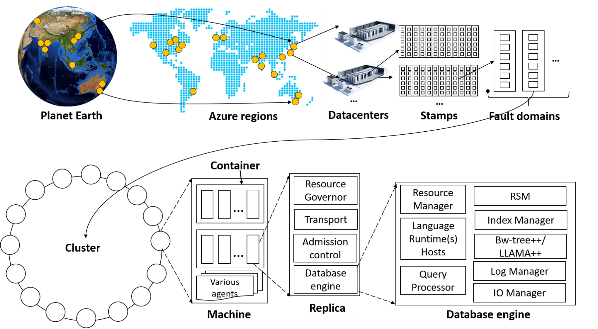
System topology (behind the scenes)
Notes:
The Cosmos DB service is deployed worldwide across all Azure regions including the sovereign and government clouds. We deploy and manage the Cosmos DB service on stamps of machines, each with dedicated local SSDs. The Cosmos DB service is layered on top of Azure Service Fabric, which is a foundational distributed systems infrastructure of Azure. Cosmos DB uses Service Fabric for naming, routing, cluster and container management, coordination of rolling upgrades, failure detection, leader election (within a resource partition) and load balancing capabilities. Cosmos DB is deployed across one or more Service Fabric clusters, each potentially running multiple generations of hardware and of varying number of machines (currently, between 60-800 machines).
Machines within a cluster typically are spread across 10-20 fault domains. The resource partitions is a logical concept. Physically, a resource partition is implemented in terms of a group of replicas, called replica-sets. Each machine hosts replicas corresponding to various resource partitions within a fixed set of processes. Replicas corresponding to the resource partitions are placed and load balanced across these machines. Each replica hosts an instance of Cosmos DB’s schema-agnostic database engine, which manages the resources as well as the associated indexes. The Cosmos DB database engine, in-turn, consists of components including implementation of several coordination primitives, the JavaScript language runtime, the query processor, the storage and indexing subsystems responsible for transactional storage and indexing of data, respectively. To provide durability and high availability, the database engine persists its index on SSDs and replicates it among the database engine instances within the replica-set(s) respectively. While the index is always persisted on local SSDs, the log is persisted either locally, on another machine within the cluster, or remotely across cluster or a datacenter within a region. The proximity of the index and log is configurable based on the price and latency SLA. The ability to dynamically configure the proximity between the database engine (compute) and log (storage) at the granularity of replicas of a resource partition is crucial for allowing tenants to dynamically select various service tiers.

Slide 28
Partitioning

Slide 29
Partitioning- Why Do We Do It In The First Place?
As data size grows, instead of buying more machines (scaling up) we distribute our data across multiple machines
Each machine is responsible for serving subset of the data.
Analogy: Working in a team

Slide 30
Partitioning
Logical partition: Stores all data associated with the same partition key value
Physical partition: Fixed amount of reserved SSD-backed storage + compute.
Cosmos DB distributes logical partitions among a smaller number of physical partitions.
From user’s perspective: define 1 partition key per container

Slide 31
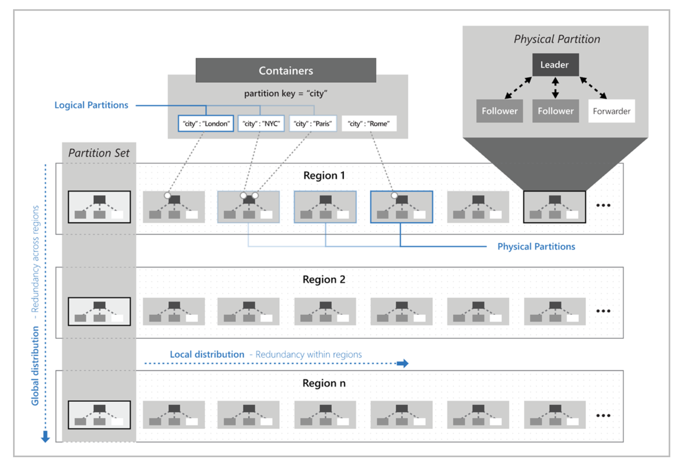
Logical to Physical Partition Mapping

Slide 32
Partitions
Partitions
hash(City ID)
….
Beijing
Redmond
Seattle
Shanghai
Paris
Partition 1
Partition 2
Partition N
Range 1
Range 2
Range X

Slide 33
Partitions
Documents with same partition key value (City ID) are in same partition
hash(City ID)
Beijing
Shanghai
….
Beijing
Redmond
Seattle
Shanghai
Paris
Partition 1
Partition 2
Partition N
Range 1
Range 2
Range X

Slide 34
Partitions
hash(City ID)
Automatically split when close to full
….
Tianjin
Austin
…
Berlin
…
Beijing
Redmond
Tianjin
+
Seattle
Shanghai
Austin
Paris
Partition x2
Berlin
Partition x1
Partition 1
Partition 2
Partition N
Range X1
Range X2
Range 1
Range 2
Range X

Slide 35
Behind the Scenes:
Physical Partition Sets
hash(User Id)
[A-F]
[G-M]
[M-T]
[U-Z]
An easier way to think of consistent hashing is to project this range of hashed values as a ring.
[A-F]
[G-M]
[M-T]
[U-Z]

Slide 36
Behind the Scenes:
Physical Partition Sets
hash(User Id)
[A-F]
[G-M]
[M-T]
[U-W]
[X-Z]
An easier way to think of consistent hashing is to project this range of hashed values as a ring.
The database can elastically scale infinitely while maintaining high availability by minimizing data movement and subdividing partitions
[A-F]
[G-M]
[X-Z]
[M-T]
[U-W]

Slide 37
RU’s divided among Partitions
10,000 RU/s provisioned for collection
Cosmos DB distributes RU/s evenly across physical partitions
hash(City ID)
2000 RU/s
2000 RU/s
2000 RU/s
….
Beijing
Redmond
Tianjin
Seattle
Shanghai
Austin
Paris
Berlin
Partition 1
Partition 2
Partition 5
Range 1
Range 2
Range 5

Slide 38
Partitions
Best Practices: Design Goals for Choosing a Good Partition Key
Distribute the overall request + storage volume
Avoid “hot” partition keys
Partition Key is scope for multi-record transactions and routing queries
Queries can be intelligently routed via partition key
Omitting partition key on query requires fan-out
Steps for Success
Ballpark scale needs (size/throughput)
Understand the workload
# of reads/sec vs writes per sec
Use pareto principal (80/20 rule) to help optimize bulk of workload
For reads – understand top 3-5 queries (look for common filters)
For writes – understand transactional needs
General Tips
Build a POC to strengthen your understanding of the workload and iterate (avoid analyses paralysis)
Don’t be afraid of having too many partition keys
Partitions keys are logical
More partition keys leads to more scalability

Slide 39
Partition Key Storage Limits
HTTP 403
Containers support unlimited storage by dynamically allocating additional physical partitions
Storage for single partition key value (logical partition) is quota'ed to 20GB.
When a partition key reaches its provisioned storage limit, requests to create new resources will return a HTTP Status Code of 403 (Forbidden).
Azure Cosmos DB will automatically add partitions, and may also return a 403 if:
An authorization token has expired
A programmatic element (UDF, Stored Procedure, Trigger) has been flagged for repeated violations
Notes:
The next could of slides have example strategies that take advantage of the 403 status code

Slide 40
Request Unit & Elasticity

Slide 41
Request Units (1 of 3)
Request Units (RUs) is a rate-based currency
Abstracts physical resources for performing requests
Key to multi-tenancy, SLAs, and COGS efficiency
Foreground and background activities
% Memory
% CPU
% IOPS

Slide 42
Request Units (2 of 3)
Normalized across various access methods
1 RU = 1 read of 1 KB document
Each request consumes fixed RUs
Applies to reads, writes, query, and stored procedures
GET
=
POST
=
PUT
=
Query
=
…

Slide 43
Request Units (3 of 3)
Provisioned in terms of RU/sec
Rate limiting based on amount of throughput provisioned
Can be increased or decreased instantaneously
Metered Hourly
Background processes like TTL expiration, index transformations scheduled when quiescent
Rate limit
Max RU/sec
Incoming Requests
No rate limiting
Min RU/sec
Replica Quiescent
Notes:
We want to avoid throttling (rate limiting)

Slide 44
Measuring RU CHARGE (1 of 2)
ANALYZE QUERY COMPLEXITY
The complexity of a query impacts how many Request Units are consumed for an operation. The number of predicates, nature of the predicates, number of system functions, and the number of index matches / query results all influence the cost of query operations.
MEASURE QUERY COST
To measure the cost of any operation (create, update, or delete):
Inspect the x-ms-request-charge header
Inspect the RequestCharge property in ResourceResponse or FeedResponse in the SDK
NUMBER OF INDEXED TERMS IMPACTS WRITE RU CHARGES
Every write operation will require the indexer to run. The more indexed terms you have, the more indexing will be directly having an effect on the RU charge.
You can optimize for this by fine-tuning your index policy to include only fields and/or paths certain to be used in queries.

Slide 45
Measuring RU CHARGE (2 of 2)
STABILIZED LOGICAL CHARGES
Azure Cosmos DB uses information about past runs to produce a stable logical charge for the majority of CRUD or query operations.
Since this stable charge exists, we can rely on our operations having a high degree of predictability with very little variation. We can use the predictable RU charges for future capacity planning.
BULK OF QUERY RU CHARGES IS IO
Query RU is directly proportional to the quantity of query results.
Notes:
Azure Cosmos DB uses ML to produce a stable logical charge for vast majority of operations (CRUD and query). This gives a high degree of predictability for capacity planning (if creating document X costs 5 RU’s today, we can rely on the fact that it will cost 5 RU’s tomorrow). This isolates RU charge from variability in physical resource utilization due to other noisy processes like garbage collection

Slide 46
RU Charge Measurement Example (1 of 3)
ResourceResponse<Document> response = await client.CreateDocumentAsync(
collectionLink,
document
);
var requestUnits = response.RequestCharge;

Slide 47

RU Charge Measurement Example (2 of 3)
client.createDocument(
collectionLink,
documentDefinition,
function (err, document, headers) {
if (err) {
console.log(err);
}
var requestData = headers['x-ms-request-charge'];
}
);

Slide 48

RU Charge Measurement Example (3 of 3)
ResourceResponse<Document> response = client.createDocument(
collectionLink,
documentDefinition,
null,
false
);
Double requestCharge = response.getRequestCharge();

Slide 49


Request Unit Pricing Example
Storage Cost
Avg Record Size (KB)
1
Number of Records
100,000
Total Storage (GB)
100
Monthly Cost per GB
$0.25
Expected Monthly Cost for Storage
$25.00
Throughput Cost
Operation Type | Number of Requests per Second | Avg RU's per Request | RU's Needed
Create | 100 | 5 | 500
Read | 400 | 1 | 400
Total RU/sec
900
Monthly Cost per 100 RU/sec
$6.00
Expected Monthly Cost for Throughput
$54.00
Total Monthly Cost
[Total Monthly Cost] = [Monthly Cost for Storage] + [Monthly Cost for Throughput]
= $25 + $54
= $79 per month
* pricing may vary by region; for up-to-date pricing, see: https://azure.microsoft.com/pricing/details/cosmos-db/

Slide 50
RU Provisioning – Provisioned Throughput
Manual
Autoscale
Introducing Burst Capacity :
With burst capacity – you can now benefit from previous, unused capacity
Compatible with provisioned throughput (manual or autoscale)
Scenario
Physicals partitions have a small amount of RU/s
A partition is idle for some time, the moment a spike happens – avoid 429s with burst

Slide 51
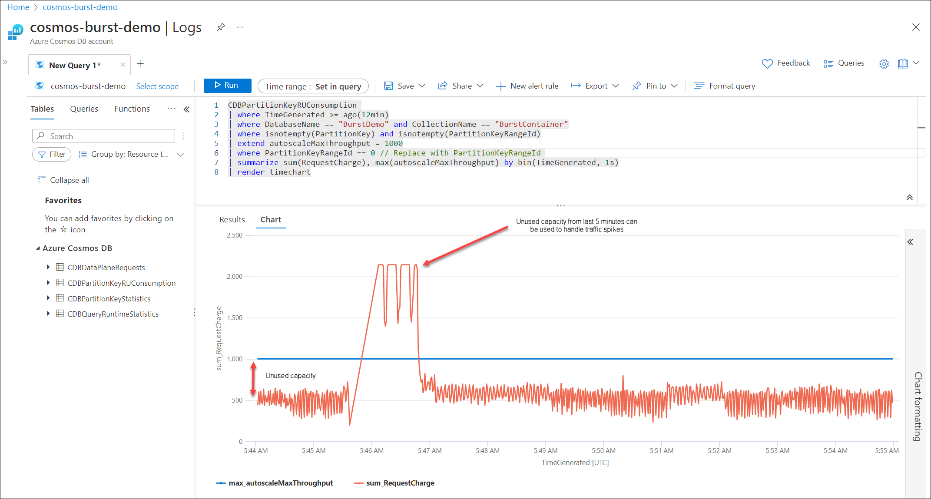
Burst capacity
Allow physical partitions to accumulate up to maximum of 5 minutes of unused capacity
This “burst capacity” can be used to burst at rate of 3000 RU/s per partition (max)
//100 – 1000 RU/s – accumulate up to 1000 RU/s
Example
Partition has 100 RU/s
Idle for 300 seconds
Accumulates 300 * 100 = 30,000 RUs
Can burst for 30,000 / 3000 = 10 seconds at 3000 RU/s
Any unused capacity in each second can be accumulated toward the burst capacity

Slide 52
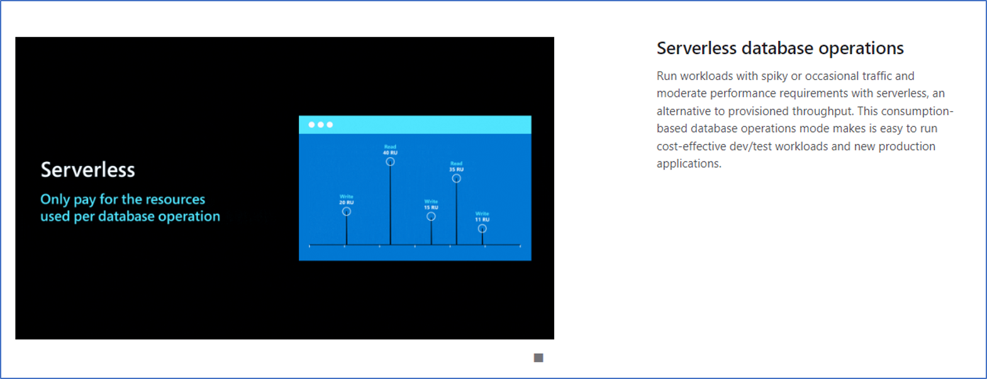
RU Provisioning – Serverless
Allows customers to use Cosmos DB and get billed only for consumed RUs and storage​
$0.25 / GB of storage; $0.25 / 1 million RUs consumed
No guarantees on latency or throughput​
Availability SLA​
99.9 without AZ​
99.95 with AZ
New 1TB container preview
Signup on Azure portal

Slide 53
Other Elasticity Preview features
Adaptive RUs – Private Preview
Burstable RUs – Private Preview
Subpartitioning – Preview
Lower autoscale minimums - Preview
Materialized Views - Preview
Notes:
Merge (private preview)
Users will be able to further optimize the performance and cost of their partition layout by merging underutilized partitions. This will be exposed as a customer-accessible API.
Burst Capacity (private preview)
Cosmos DB’s autoscale has does a great job optimizing customer costs for hourly traffic cycles. Customer scenarios that require predictable performance guarantees of provisioned throughput and also have traffic cycles at frequencies quicker than an hour will have now have access to burst capacity. Burst capacity enables customers to further optimize their costs by more tightly fitting their autoscaled throughput to their request traffic as a finer granularity.
Adaptive RUs - Per-Partition RU/sec (private preview)
Cosmos DB provides unlimited request throughput by scaling out containers to many backend partitions. In an ideal world – customers are able to choose a partition key that allows for perfectly even distribution of load-balanced request traffic across these partitions. In practice, even load distribution isn’t always possible. Per-Partition RU/sec will enable customers to configure their partitions to have heterogenous RU/sec layouts to further optimize costs for uneven workloads.
Subpartitioning (public preview)
Customers will be able to define hierarchical partition keys that are a composite over multiple values. The hierarchy allows for intelligent optimal routing of requests when only a subset of partition key values are known; while simultaneously enabling customers to manage outlier partition key values that must exceed 20GB of storage (per partition key).

Slide 54
Azure Cosmos DB HTAP for OLTP & OLAP

Slide 55





Running OLTP and OLAP workloads on the same database
If you have large amounts of data, analytical queries will take a long time to run and will be resource intensive.
HUGE performance impact on the OLTP workloads.
Real-time
Applications & Services
Azure
Cosmos DB
Reporting & Dashboards
Notes:
Data volume =>OLTP performance impact

Slide 56

Benefits of running HTAP in Cosmos DB and Synapse
Operational Needs
High throughput ingestion of both batch & streaming feeds with real-time indexing
Global distribution with active-active setup
Apps to perform real-time CRUD & queries using developer friendly NoSQL APIs
No downtime elastic scaling of database
SLAs for latency/availability/consistency/throughput
Analytics Needs
Run analytics without impacting operational performance
Low cost on storage and compute to run near-real time analytics workloads
Analyze in-place data, eliminating ETL complexity, with Synapse Spark and SQL
Rich BI ecosystem of SQL available for cheaper & faster queries over analytical storage
Native integration of Azure Enterprise AI ecosystem for training and scoring ML models over analytical storage

Slide 57





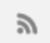

Azure Synapse Link : How it works?
Transactional Store
Row store optimized for transactional operations
Analytical Store
Column store optimized for analytical queries
Machine learning
Container
Operational
Data
Cloud-Native HTAP
Big data analytics
Auto-Sync
Azure Synapse Link
SQL
BI Dashboards
Azure Cosmos DB
Azure Synapse Analytics
Generate near real-time insights on your operational data
Notes:
So what’s the magic powering Synapse Link?
First animation:
So far, your operational data in Cosmos DB is internally stored in a row-oriented ‘transactional store’. This store is optimized for transactional reads/writes & operational queries.
Second animation:
Now, we’re excited to bring you a fully-managed native ‘analytical store’ within Azure Cosmos DB container. Analytical store is a fully-isolated column-oriented store, optimized for typical analytical queries over large volumes of data.
Your inserts, updates, deletes to operational data are automatically synced from transactional store to analytical store in near real-time within minutes. This ‘auto-sync’ capability does not consume RUs allocated for your operational workloads.
Third animation:
Now with Synapse Link, you can connect Cosmos DB Analytical store with Synapse Analytics with a ‘single click’. This allows you to interchangeably query operational data in Cosmos DB using Spark & SQL runtimes.
This enables you to build machine learning pipelines, BI dashboards and run big-data analytics in near real-time on your operational data.

Slide 58
Azure Cosmos DB: What Comes Next
Product is evolving quickly with investments across 3 key pillars:
Ready for Mission Critical
Instant Recovery (RTO ~0) + Forced Failover
Cost Effectiveness at any scale
Elastic autoscaling that “just works” (burstable, per partition RUs)
Fast, flexible App Development
Always encrypted (GA)
Purview access policies
Continuous Backup
Increased Serverless Scalability (1 TB)
Change Feed Op Log
Integrated Cache (GA)
Open-source API updates (API versions, 16mb doc size)
GraphQL support
Aggregation Performance Improvements
Notes:
Advance to the next slide after the mention of the third point Drive innovation with new cloud native apps

Slide 59
Closing
Azure Cosmos DB Certification : DP 420
Provide feedback , comments, topics you want to hear about : please send email to cosmospartnersuccess@microsoft.com
Attend Partner Tech Connect (gotcosmos.com) for upcoming special topic sessions and Q&A sessions.
Ask technical questions on Posts containing 'cosmos db' - Stack Overflow with tag :cosmos db”. We will answer this here. Any Other ideas welcome ?
Resources
Workshops & Slideware: https://azurecosmosdb.github.io/CosmosDBWorkshops/#slides
Cosmos DB Blog : https://devblogs.microsoft.com/cosmosdb/
Main Documentation: https://docs.microsoft.com/en-us/azure/cosmos-db/
Cosmos DB Youtube Channel : https://www.youtube.com/azurecosmosdb
MS Learn: https://docs.microsoft.com/en-us/learn/paths/work-with-nosql-data-in-azure-cosmos-db/
Pluralsight courses (free MS FTE access): https://microsoft.sharepoint.com/_layouts/15/search.aspx/?q=pluralsight
Channel 9 events (Build, Ignite) : https://channel9.msdn.com/
Twitter : @AzureCosmosDB ; #AzureCosmosDB , #CosmosDB

Slide 60
Q & A

Slide 61






Platinum Partner
Gold Partner
Silver Partner

